Slide 1
Workshop: iOS Testing
HungNV
ChauNN

Slide 2
Overview
Session 1: Introduced Kaizen iOS template.
Session 2: iOS automation test – XCUITest.
Session 3: Unit test – Quick & Nimble.

Slide 3
Session 1: Kaizen iOS template
Github link: https://github.com/vitalifyjp/Kaizen_IOS_Template
Coding role:
Document: https://vfa-chaunn.gitbook.io/kaizen-ios-template-gui/

Slide 4
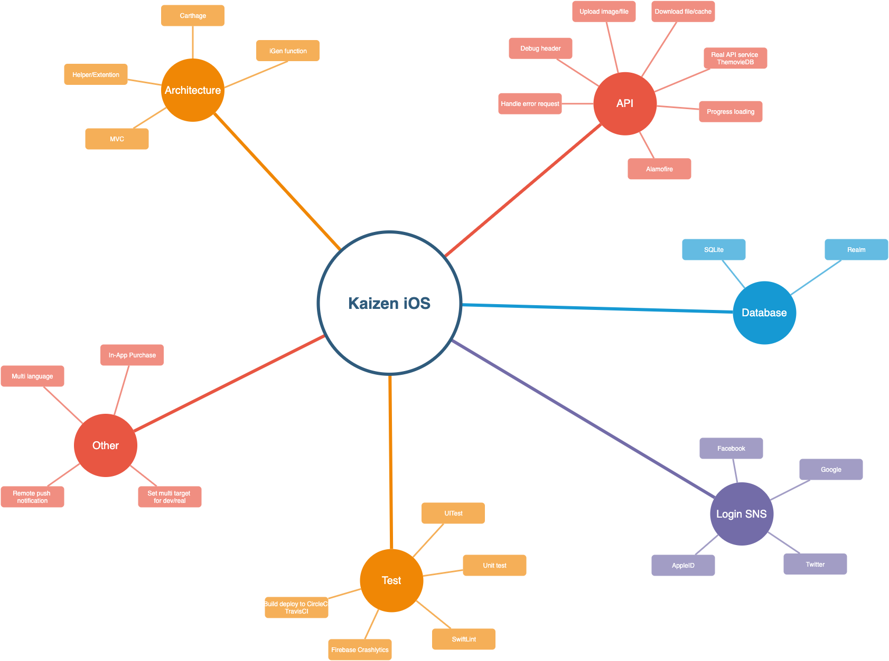
Functions

Slide 5
Session 2: iOS UI Testing in Xcode (iOS Automation)

Slide 6
Overview
Introduction XCUITest.
Record and Playback.
Demo.

Slide 7
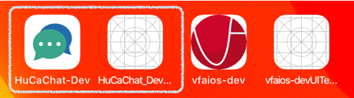
XCUITest
Introduced in Xcode 7 in 2015
xUnit Test cases (XCTestCase)
UITest targets can’t see production codes
Builds and tests are all executed using XCode (ObjC/Swift)
Record functionality

Slide 8
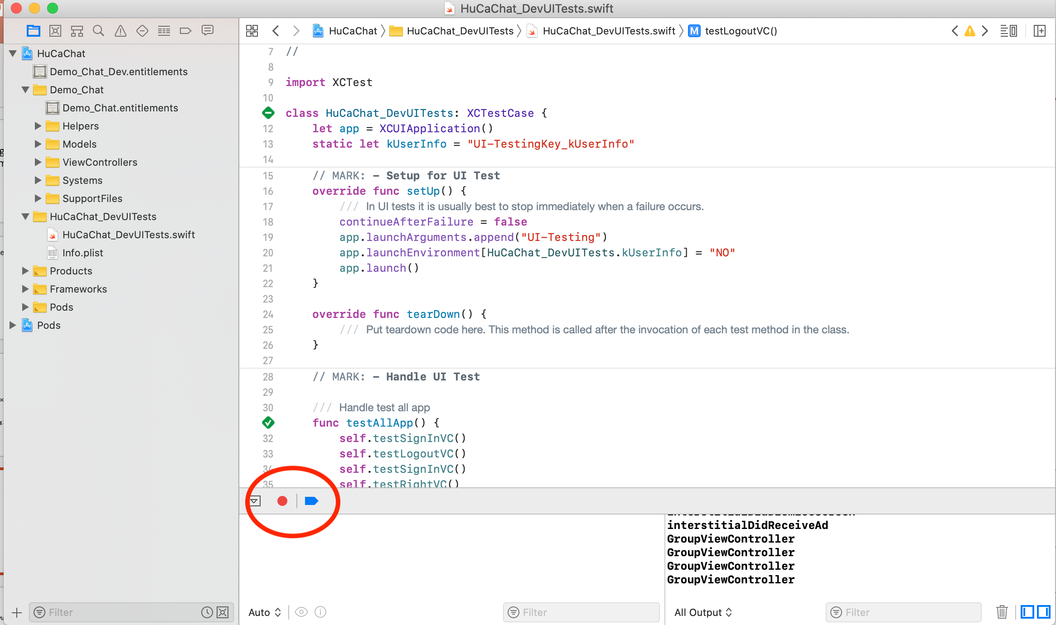
XCUITest – Recording and playback

Slide 9
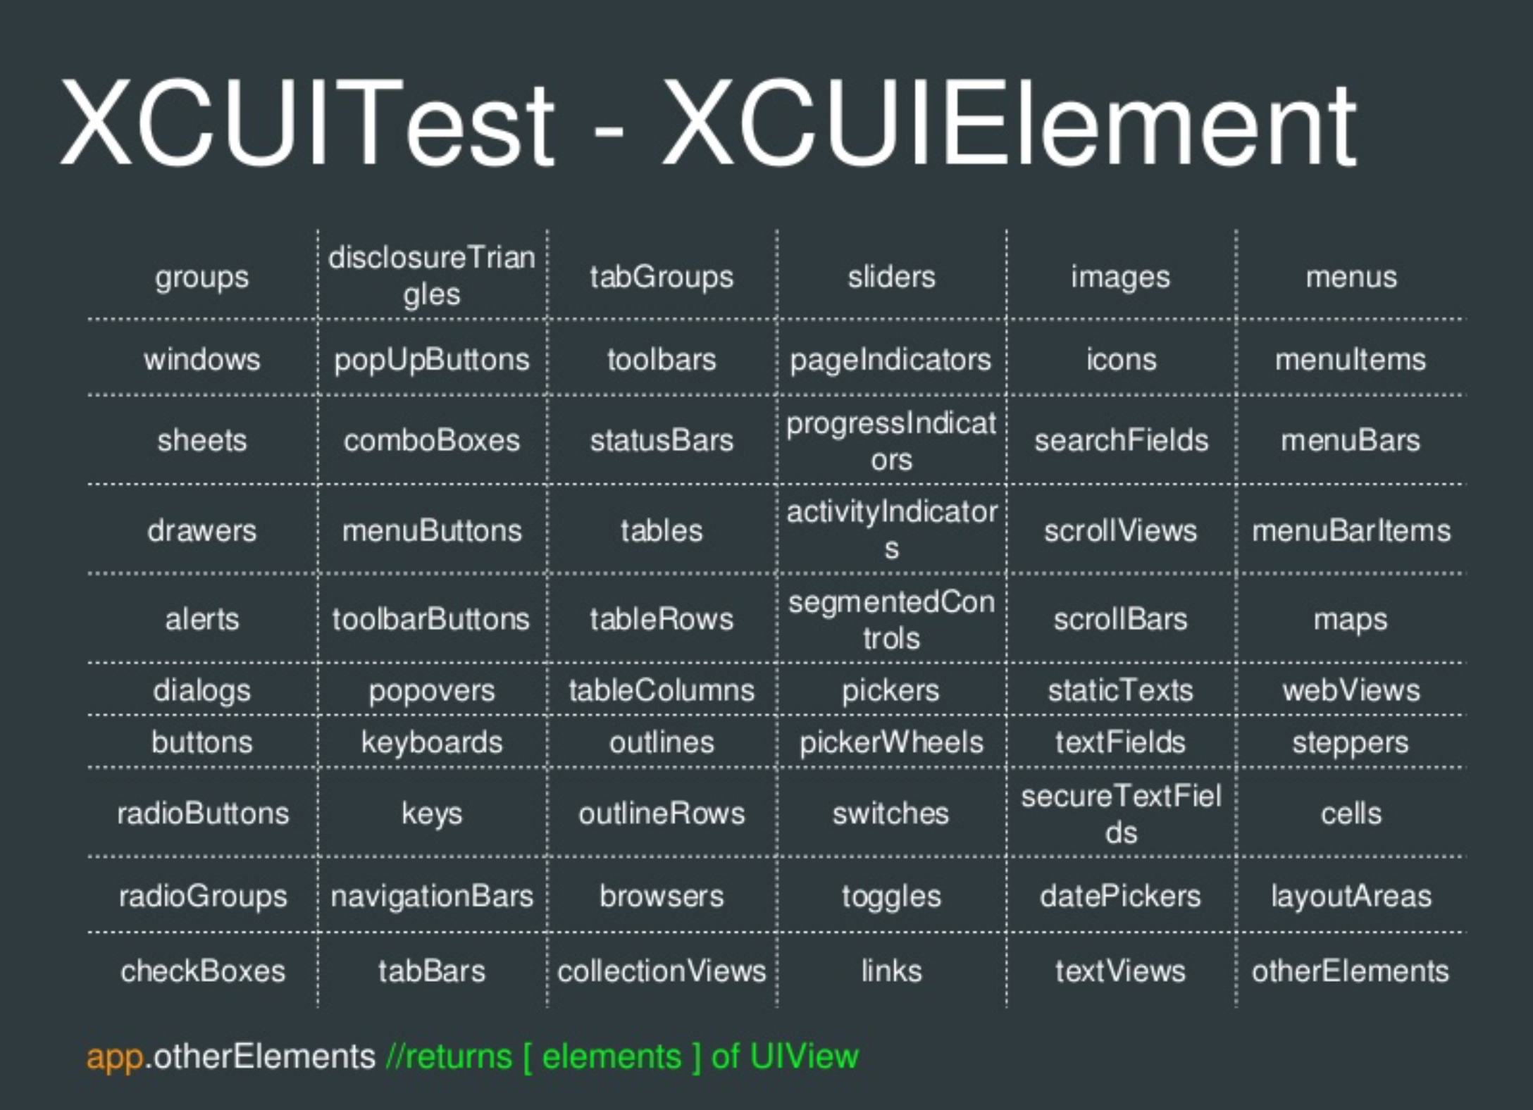

Slide 10
Demo
Demo 1: UI Recording – Record and Playback
YouTube link
Demo 2: How does iOS automation work?
Github: https://github.com/vfaHungnv/simpleapp/tree/develop

Slide 11
Session 3: Unit test – Testing with Quick & Nimble.

Slide 12
Overview
Introduced XCTest vs Quick and Nimble.
How to use Quick and Nimble.
Demo.

Slide 13
Comparison between XCTest vs Quick and Nimble
XCTest is a testing framework provided by Apple. You need to be aware of setup() and tearDown() functions. XCTAssertions are also pretty inconvenient to use. Very long function names.
Quick is a testing framework which provides a convenient method to compose a unit test. It uses the single function spec() to define the whole test. The sections are describe, context and it. I will explain the purpose and benefits of such a setup later in this article.
Nimble is a matching framework which provides plenty of options how to fulfill your test expectations.

Slide 14
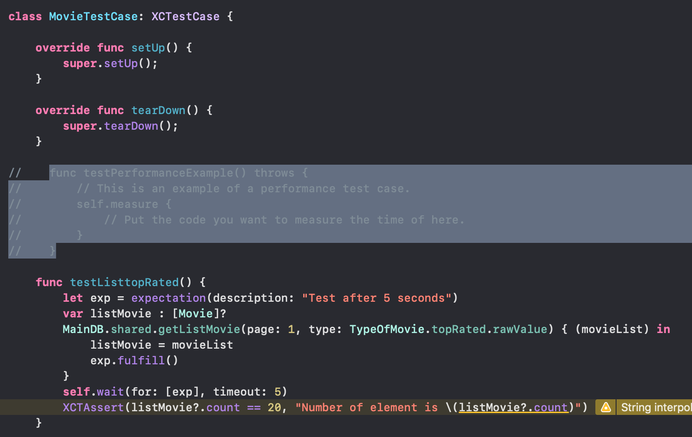
Introduction XCTest

Slide 15
SetUp: method called before the invocation of each test method in the class.
TearDown: method is called after invoking the test method (if applicable)
Fulfill: mark an expectation as having been met
Wait: wait on a group of expectations for up to the specified timeout. May return early based on fulfillment of the waited on expectations.
XCAssert: method to compare

Slide 16
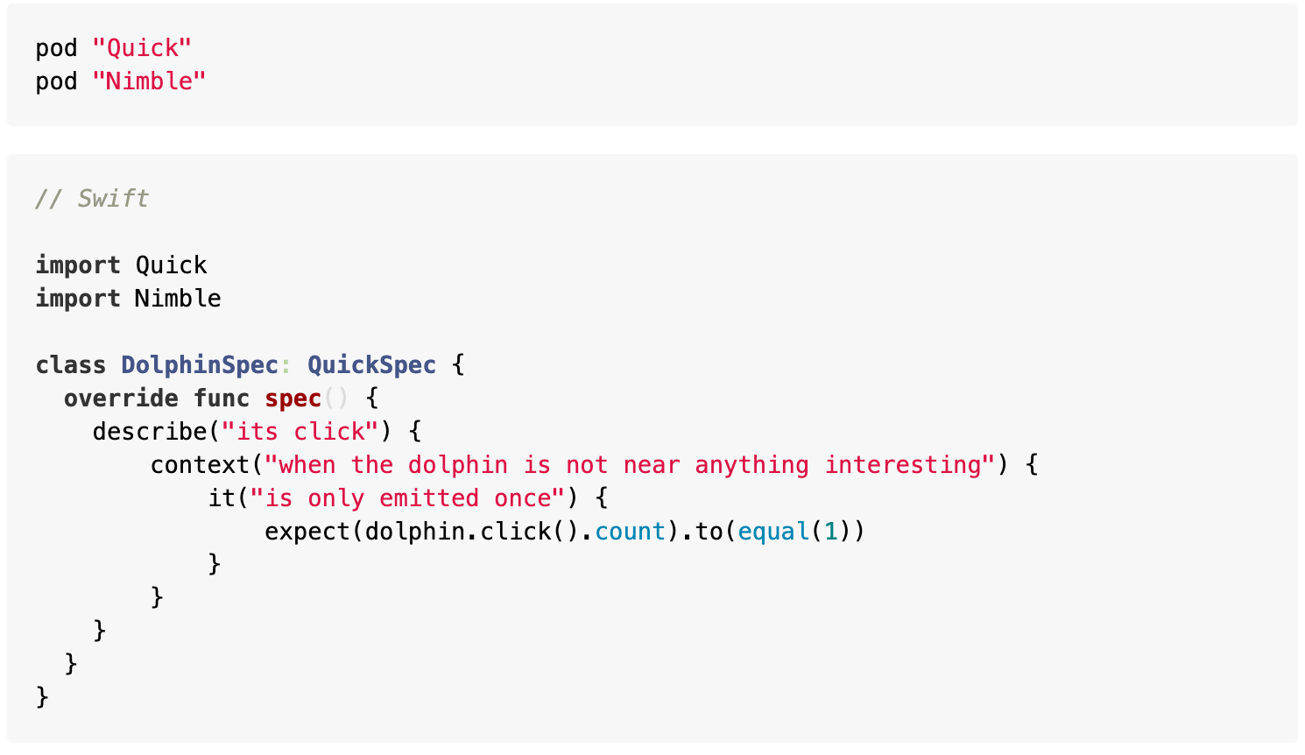
How to use Quick and Nimble
You can either use Cathage or Cocoa Pod.

Slide 17
Introduction Quick
- description: An arbitrary string describing the example group.
- context: Defines an example group. Equivalent to `describe`.
- it: Defines an example. Examples use assertions to demonstrate how code should behave. These are like "tests" in XCTest.

Slide 18
Script for test case.
Test number of element movie into from API .
Test correct url thumbnail for each movie from API.
Test number of music into local DB.
Test change data of music into local DB.
Test delete music into local DB.

Slide 19
Reference
Quick and Nimble: https://medium.com/inloopx/tdd-using-quick-nimble-244b14b09e3d
UITest call API: https://www.raywenderlich.com/960290-ios-unit-testing-and-ui-testing-tutorial
UITest: https://useyourloaf.com/blog/ui-testing-quick-guide/
UnitTest – Quick & Nimble: https://medium.com/inloopx/tdd-using-quick-nimble-244b14b09e3d

Slide 20
Q.A – Thank you!!!

